Slide 1
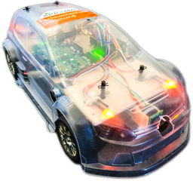
Developing a Multicore RC-Car with APP4MC
Mustafa Özçelikörs, Robert Höttger
EclipseCon Ludwigsburg, Germany
26.10.2016

Slide 2
Outline
APP4MC Introduction
Introduction to Multi-core programming
APP4MC RC-CAR
Hardware Architecture
Software Architecture
Modeling a system with APP4MC

Slide 3

APP4MC (aka Amalthea) I
An open source development platform for embedded multi- and many-core systems
Itea2 project
German funding by BMBF
20 partners
7,8 mio€
80 person years
Sep.2014 – Aug.2017
Notes:
Who?
Project

Slide 4
APP4MC Architecture I
Notes:
What?

Slide 5
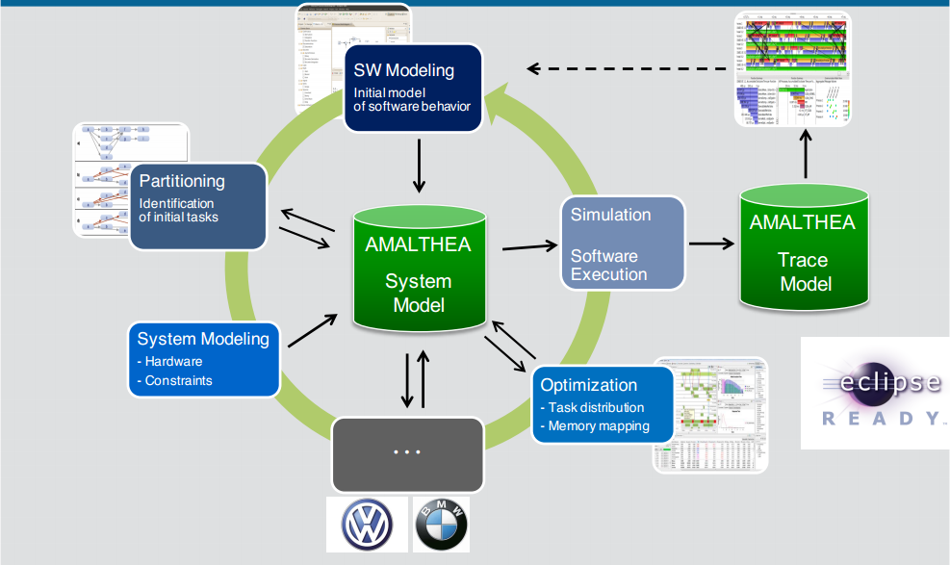
APP4MC Architecture II

Slide 6
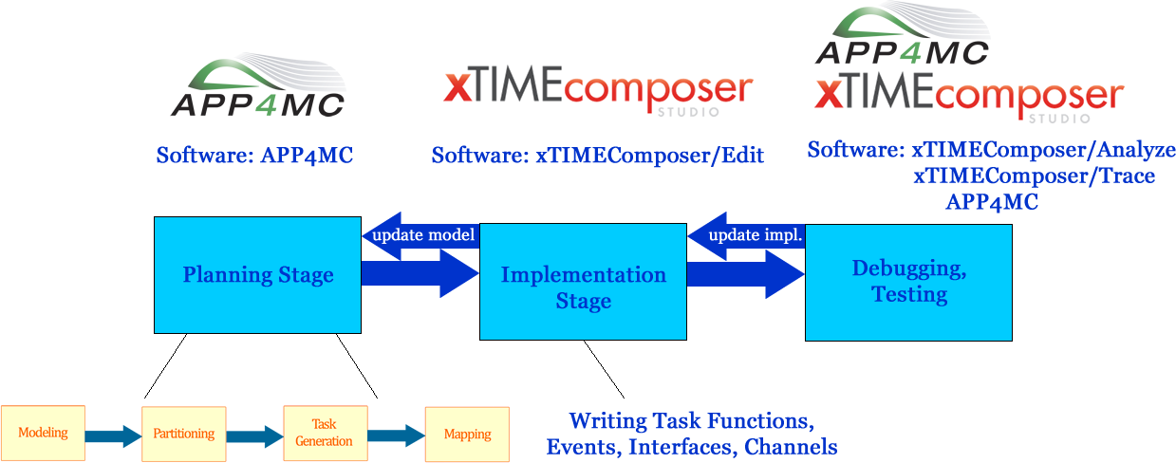
Introduction to Multicore Programming

Slide 7
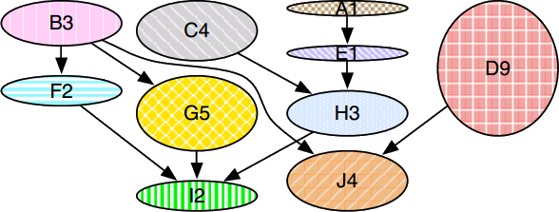
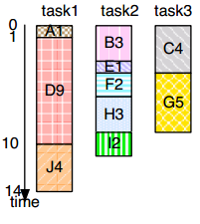
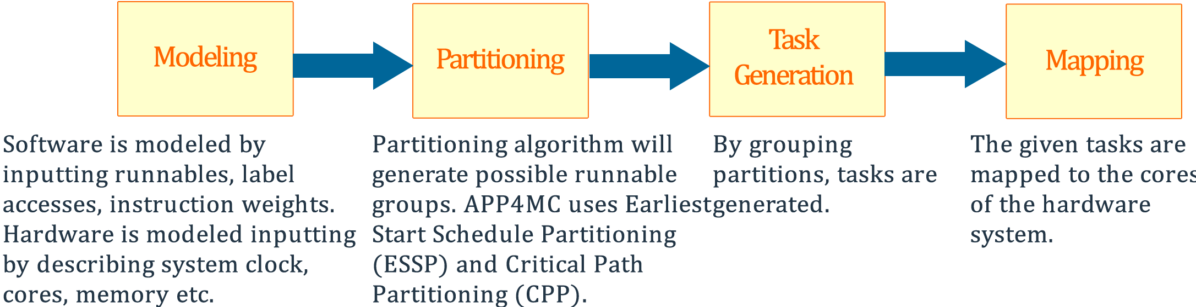
Introduction to Multi-core programming
B3, C4, F2, G5, A1, I2, E1, H3, J4, D9
/rearranging

Slide 8
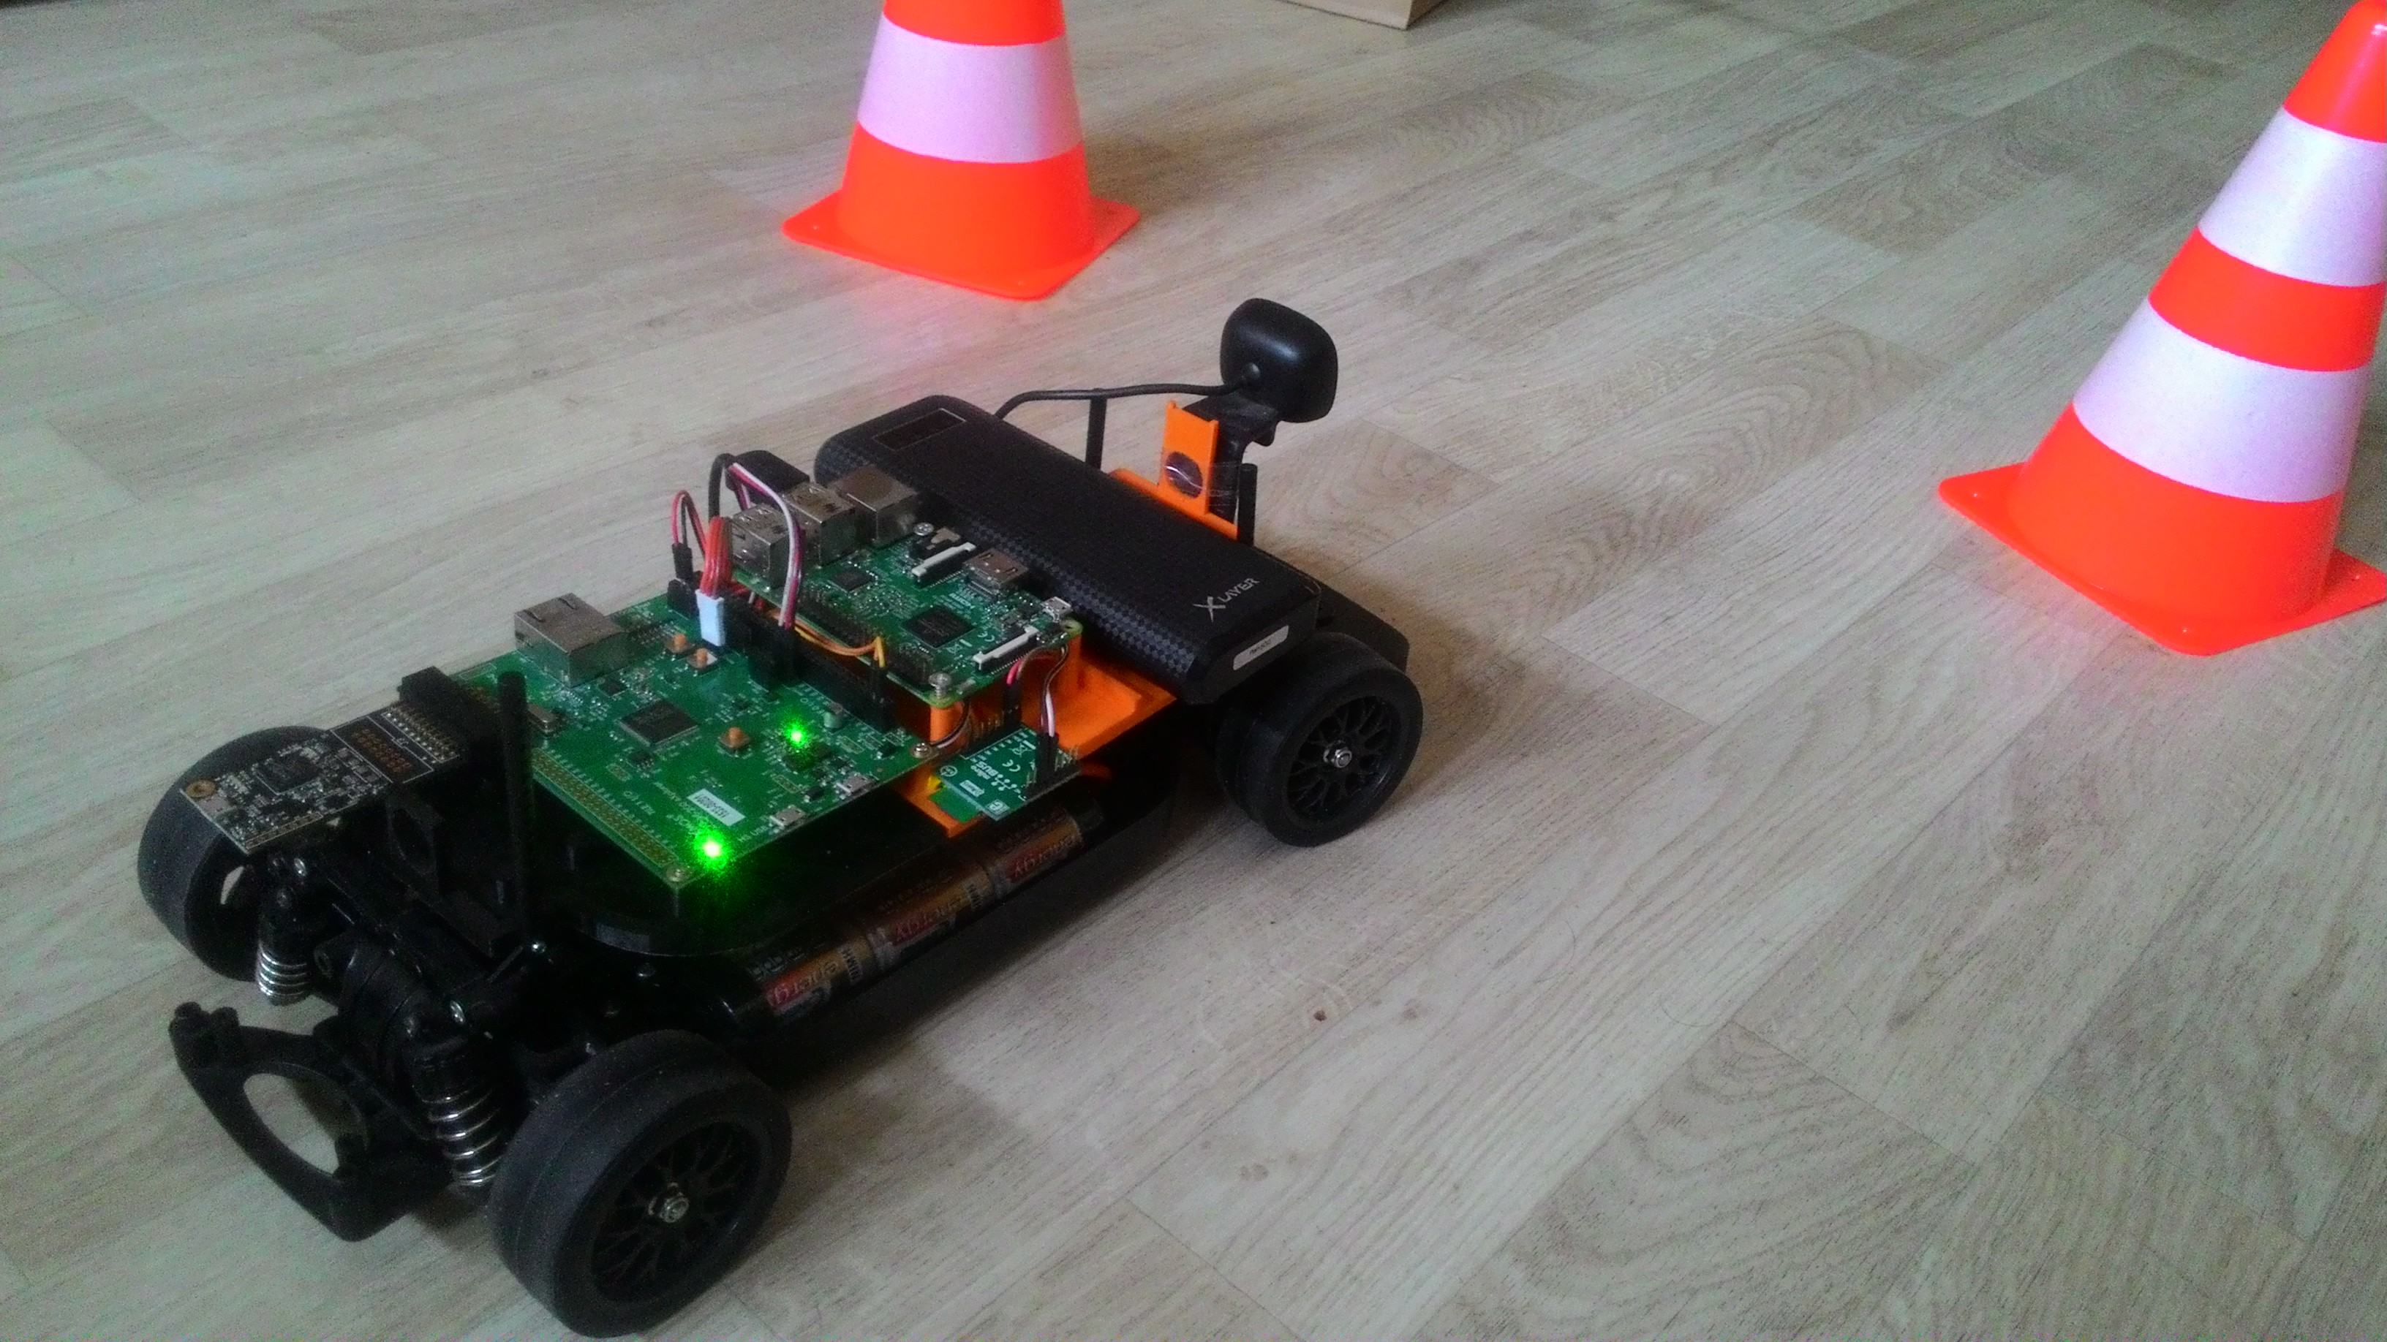
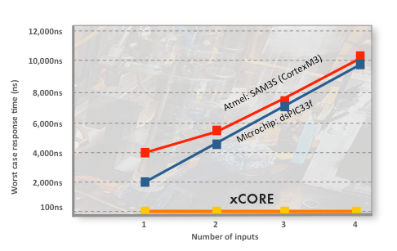
APP4MC RC-CAR
XMOS XE-216 Multicore
16 logical cores, 2 tiles
Single cycle instruction execution
Programmed with xC
A C extension with
Event mechanism
Client-server ports
Software components
Interfaces, Streaming channels
Source: XMOS
Notes:
-- xC resembles SystemC a lot.

Slide 9
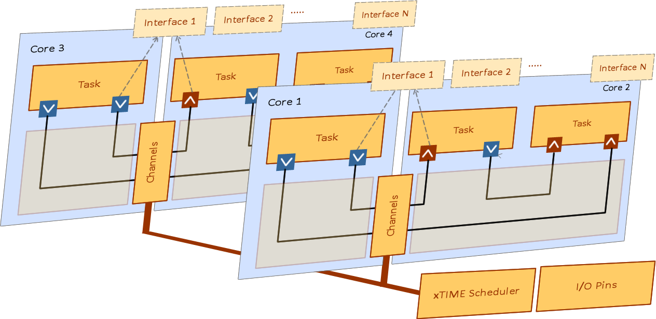
XMOS Architecture
Multiple processing cores – Runs multiple tasks concurrently
• Immediate response time – 100x faster than other MCUs
• Flexible ports and peripherals – Supports fast complex interfaces – Multiple peripherals in one chip
• RTOS features in hardware – Scheduler, timers, communications – Predictable repeatable behavior – Low latency
• Integrated development tools – Programmed in C and C++ – Instrumentation/trace libraries – Static timing analyzer
• Multicore extensions for C – Concurrent tasks, timing, communication, I/O, memory management
Source: XMOS xCORE Architecture Flyer
Notes:
https://www.xmos.com/download/private/xCORE-Architecture-Flyer%281.1%29.pdf

Slide 10
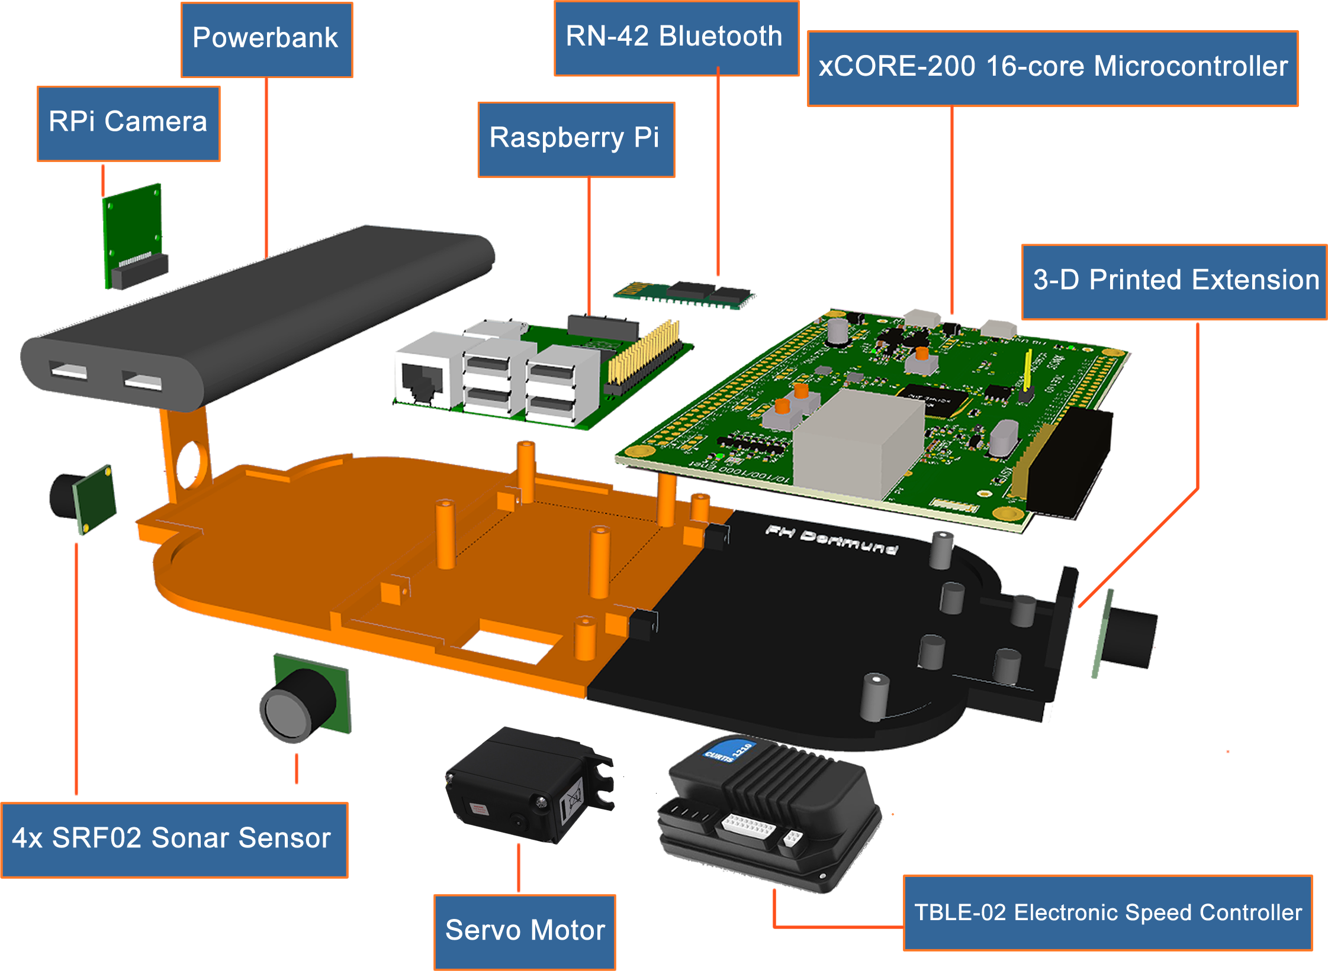
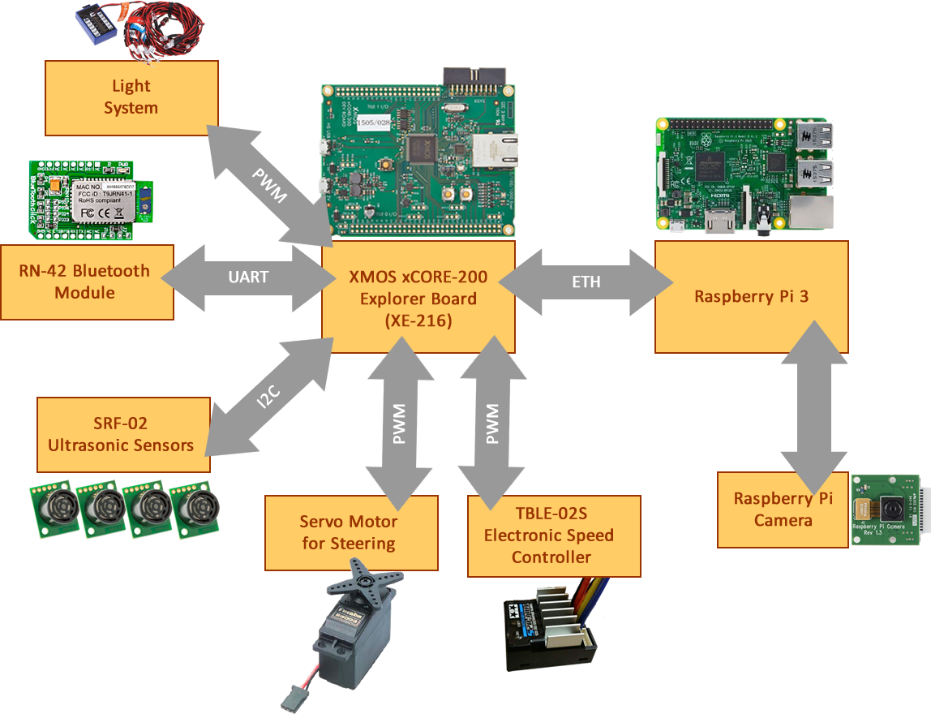
RCCar Hardware Setup
Notes:
-- xC resembles SystemC a lot.

Slide 11
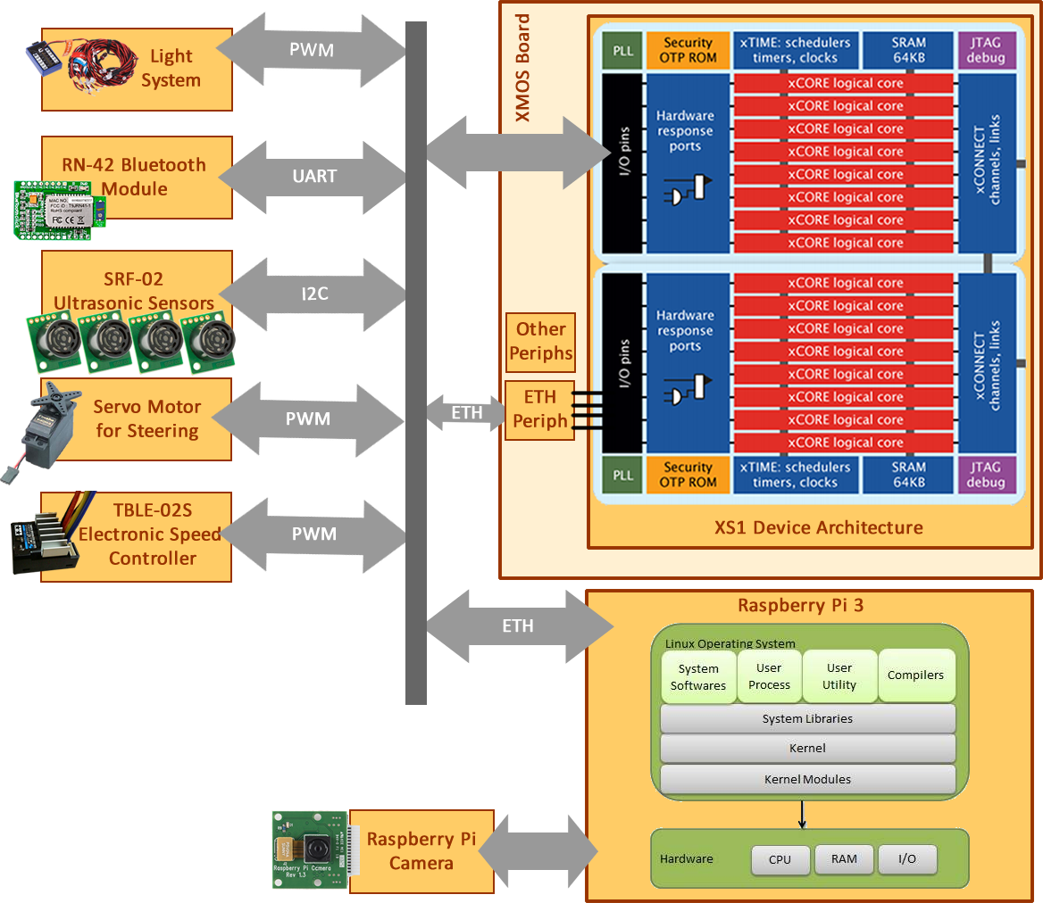
Hardware Archt.
Notes:
Reduced Gigabit Media Independent Interface (RGMII) specifies a particular interface between an Ethernet MAC and PHY.
RGMII uses half the number of pins as used in the GMII interface. This reduction is achieved by clocking data on both the rising and falling edges of the clock, and by eliminating non-essential signals (carrier-sense and collision-indication). Thus RGMII consists only of: RXC, RD[3:0], RX_CTL, TXC, TXD[3:0], and TX_CTL (12 pins, as opposed to GMII's 24).
Unlike GMII, the transmit clock signal is always provided by the MAC on the TXC line, rather than being provided by the PHY for 10/100 Mbit/s operation and by the MAC at 1000 Mbs.
RGMII supports Ethernet speeds of 10 Mbit/s, 100 Mb/s and 1000 Mbit/s.

Slide 12
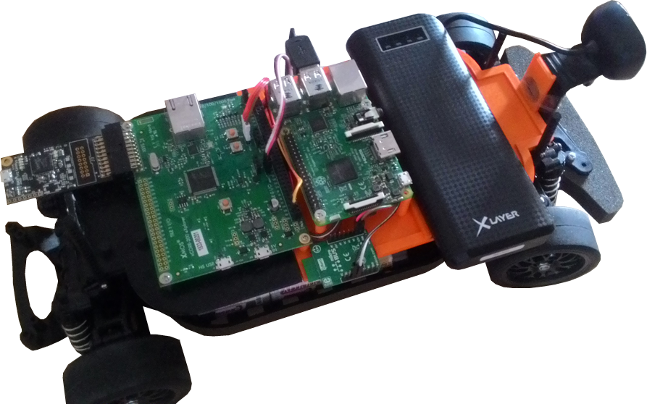
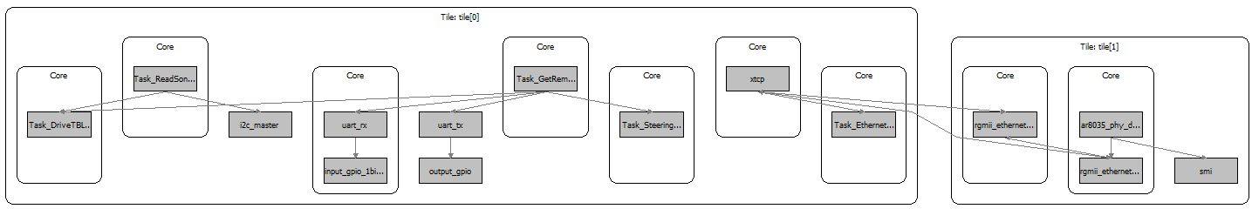
Initial Task Partitioning
Main Tasks
Task 1: Read Sonar Sensors
Task 2: Serial Port Connection
Task 3: Drive Steering Servo Motor
Task 4: Drive Motor Driver
Task 5: Get Remote Bluetooth Commands
Task 6: Maintain I2C Connection
Task 7: TCP Connection
Task 8: Ethernet Driver
Task 9: TCP Server
1
5
7
2.1
2.2
4
6
3
9
8

Slide 13
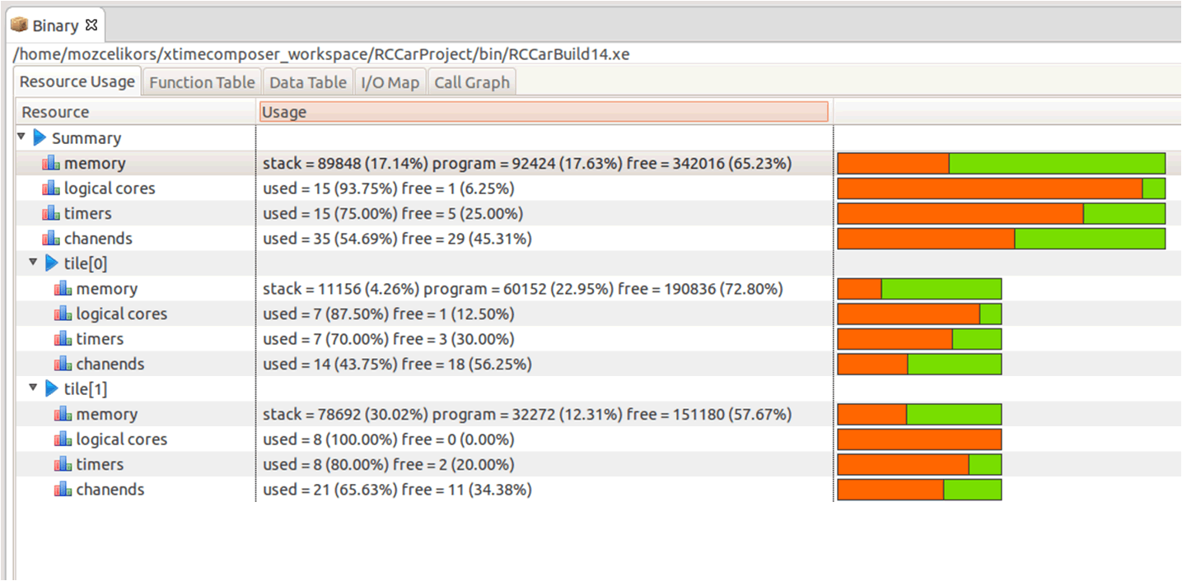
Modeling the System with APP4MC
xTIMEComposer provides Binary information about the projects.
Stack sizes
Task precedence
I/O Map
Interfaces
Hardware / other resources
This information is useful to model with APP4MC.

Slide 14
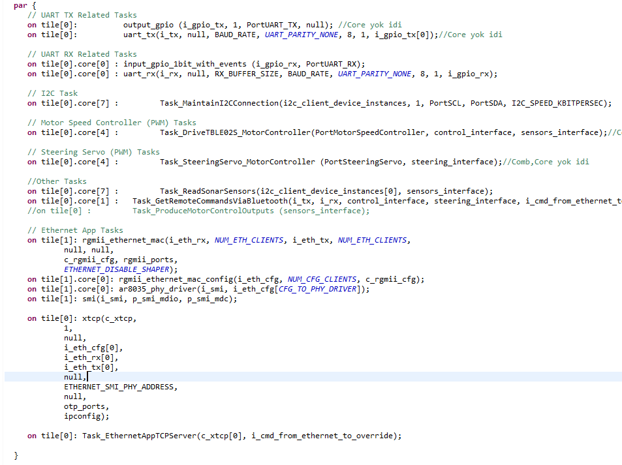
Implementation

Slide 15
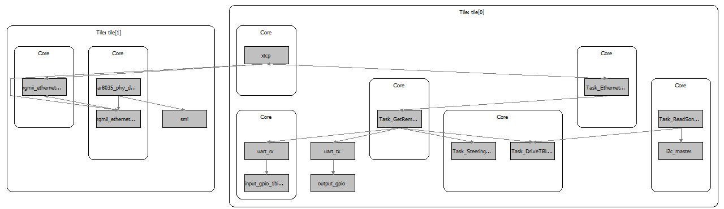
APP4MC RC-CAR SW Architecture

Slide 16
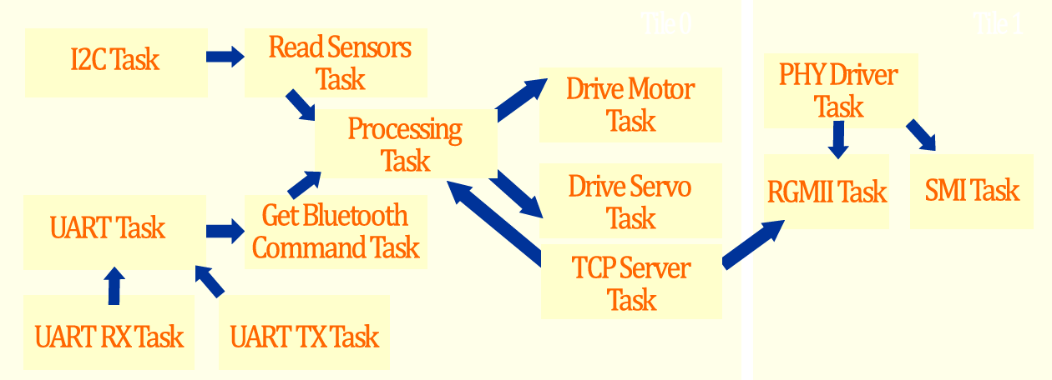
APP4MC RC-CAR SW Architecture

Slide 17
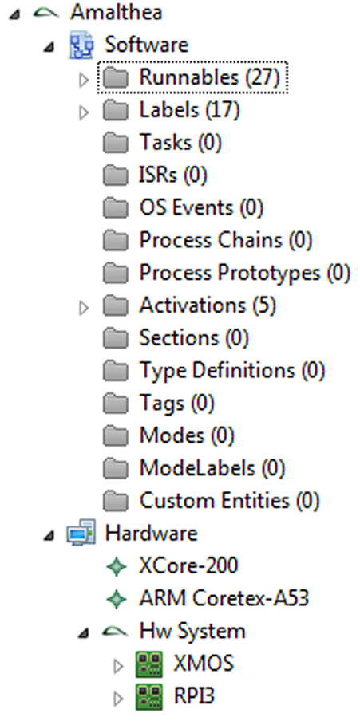
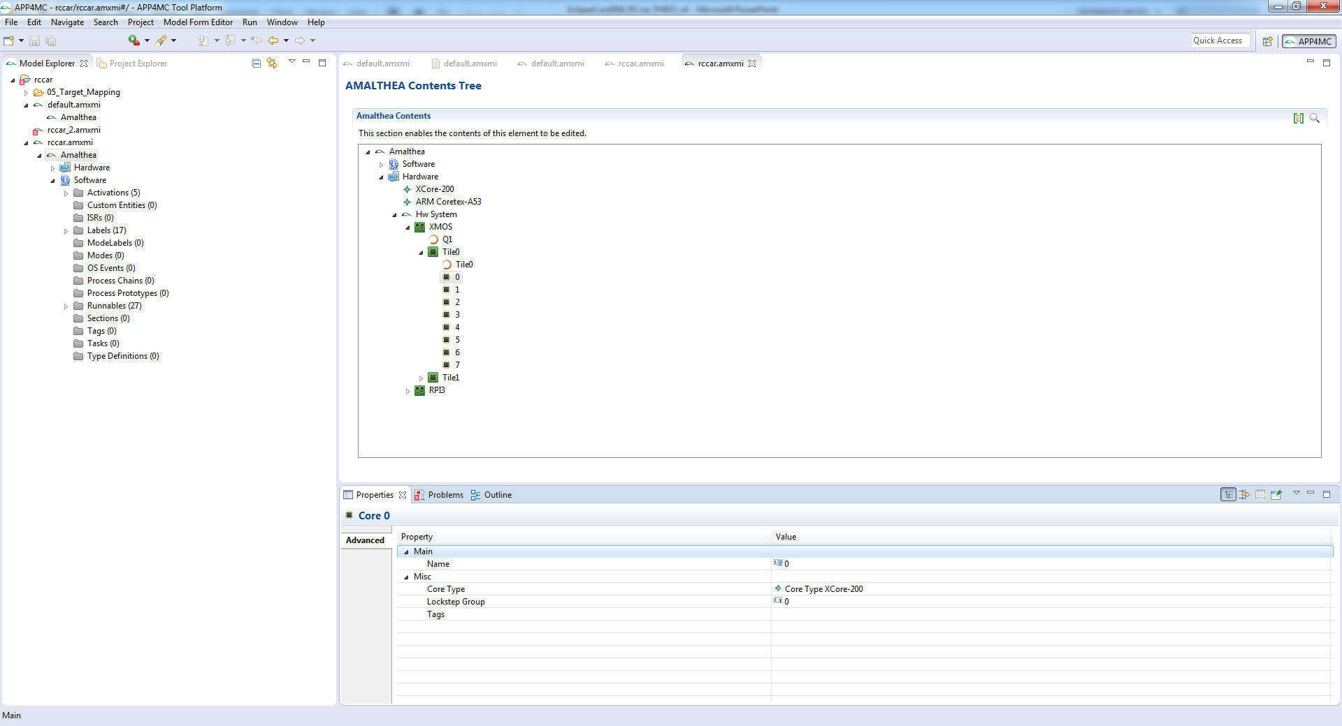
APP4MC & RC-CAR Quick Demo

